Slide 1






Family and Divorce
Harpreet Saund
January 2024
rlksolicitors.com

Slide 2





Harpreet Saund
Head of Family
Chartered Legal Executive
0121 450 7800
hsaund@rlksolicitors.com
Birmingham

Slide 3




Topics for today
Unmarried Couples
Financial Settlements in Divorce
Disputes in relation to Children
Funding options in Family Law

Slide 4


Unmarried couples
What is the term 'cohabiting family'?
Is a cohabiting couple legally called ‘A common law Husband and Wife’?
Have I got any protection if I move in with my partner and we don’t get married?

Slide 5
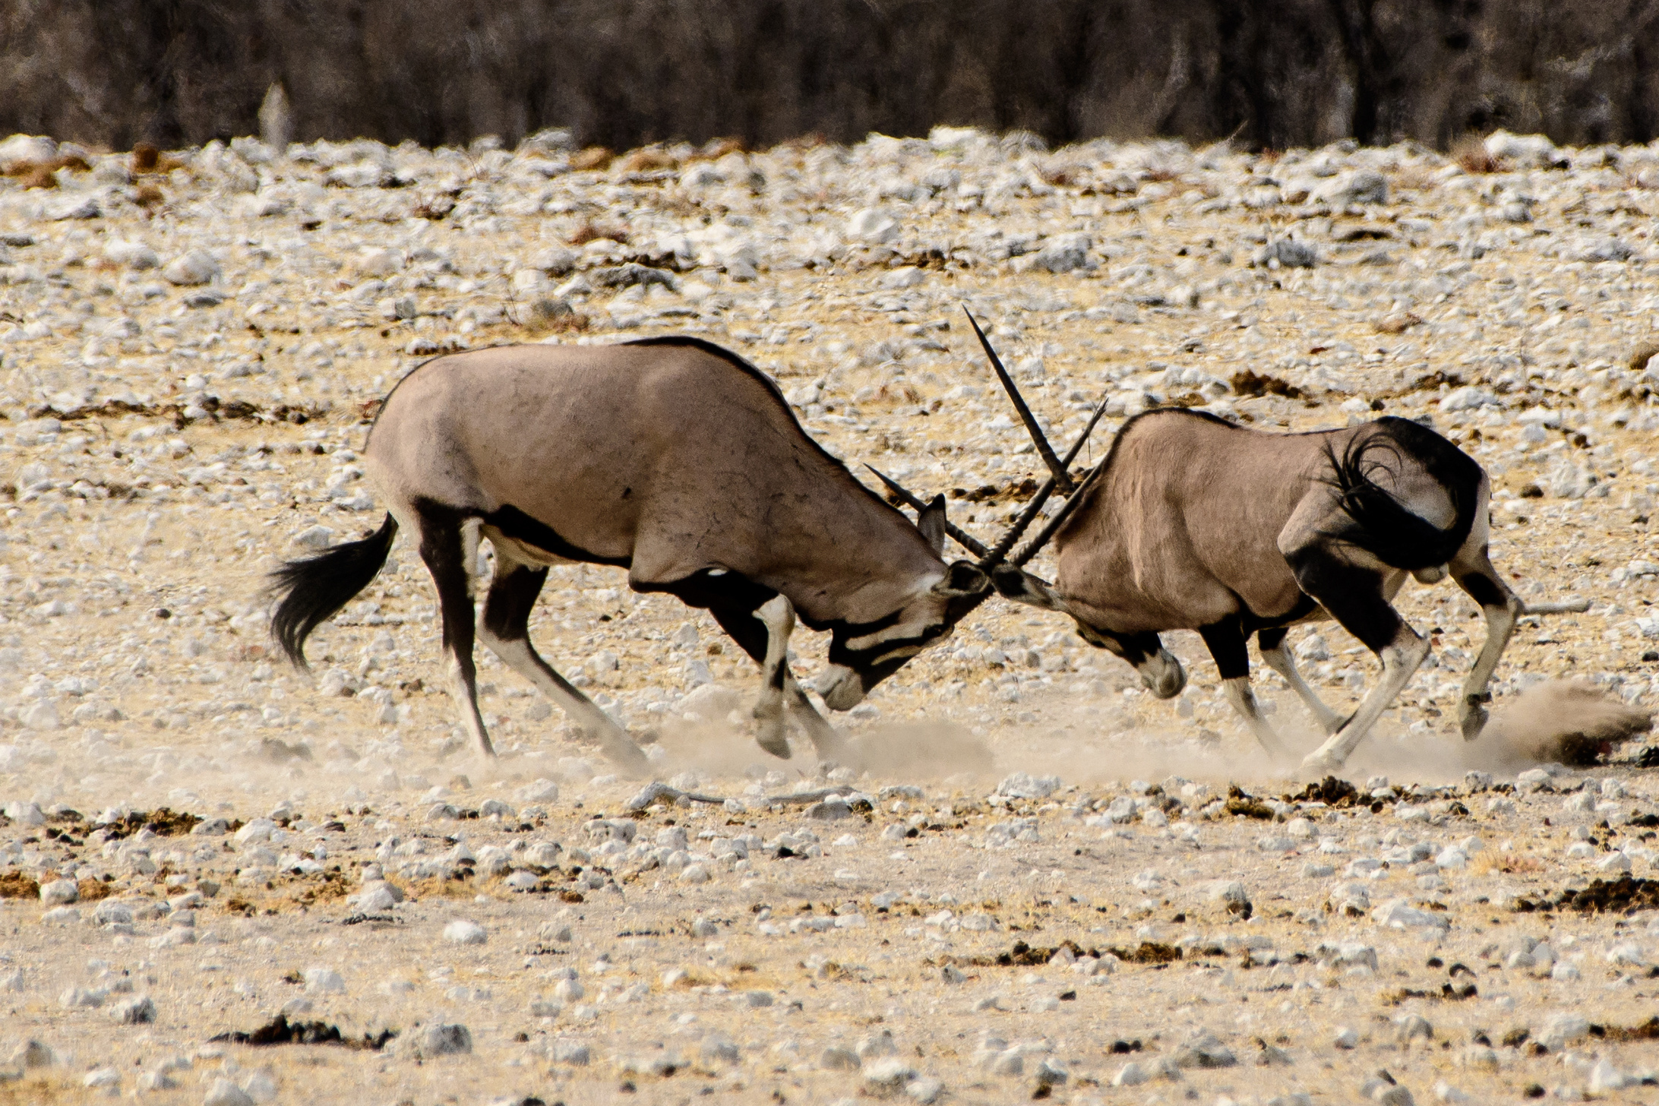
Financial Settlements in Divorce
Is there such a thing as a ‘quickie’ divorce?
Do I need a solicitor for a divorce?
What are the powers of the court when I get divorced and how do I sort out the finances?
Is there always a 50/50 spilt of assets in a divorce?

Slide 6

Disputes in Relation to Children
What orders are available to me if I separate from my partner or decide not to stay with my partner after our child is born?
It is a common myth that women automatically have access of the children.
Do I need the other parent’s permission to take our child on holiday?
Do grandparents have any rights?

Slide 7

Funding options in Family Law
I am going through a divorce/separation and therefore won’t have the money for my legal fees – what options do I have?

Slide 8


Harpreet Saund
0121 450 7800
hsaund@rlksolicitors.com
Birmingham
Any Questions?
rlksolicitors.com

