Slide 1

Week
22- 28 April

Slide 2
Welcome
Gareth Penn – Hair & Barber Council
Nick Plunkett – TrichoCare Education
Raymond Bottone – My Salon Manager
Adam Haste – Sentio Salons

Slide 3
Objectives this evening
Quick update on Hair & Barber Council
Allergy Awareness Week
Benefit of allergy knowledge for hairdressers and clients
Recap of allergy issues in salons

Slide 4
Quick update
Report service VAT & protest
Spring Statement
Debate in Parliament – 23 April
Enforcement and self-employment
Barbers

Slide 5
Free Training
Allergy Awareness
https://trichocare.litmoseu.com/self-signup/
AAW25

Slide 6
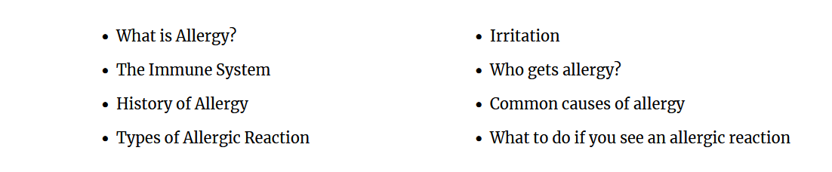

Slide 7
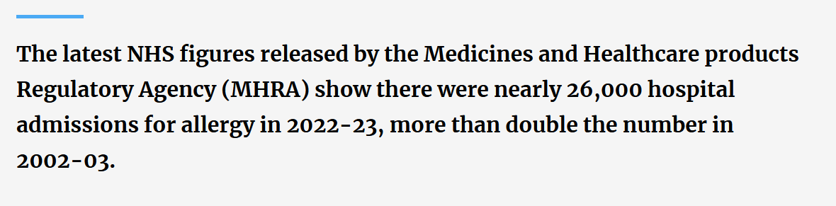
Allergy Awareness

Slide 8
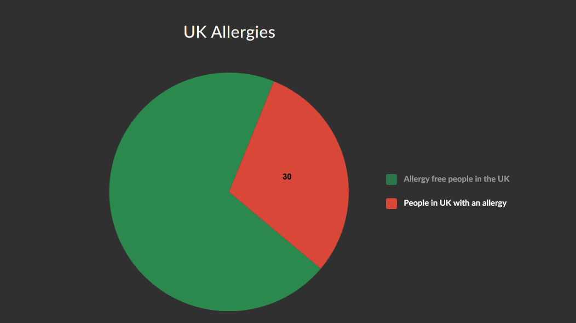

Slide 9
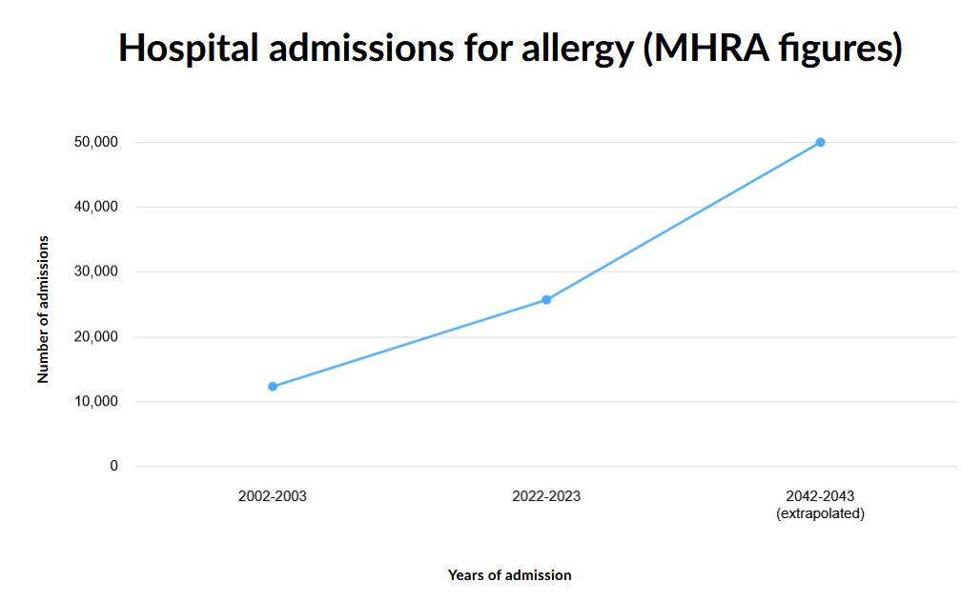

Slide 10
Why?
Discussion

Slide 11
For further info
Contact details:
Gareth Penn gareth.penn@haircouncil.org.uk
Nick Plunkett nick.plunkett@trichocare.co.uk
Adam Haste adamh@sentiosalons.co.uk
Raymond Bottone raymond@mysalonmanager.co

